Slide 1

Apex Institute of Technology
Department of Computer Science & Engineering
Bachelor of Engineering (Computer Science & Engineering)
Design and Analysis of Algorithms– (21CSH-282)
Prepared By: Mr. Vikas Kumar (E13657)
DISCOVER . LEARN . EMPOWER

Slide 2
Content
Divide and Conquer: Understanding of the divide and conquer approach
Example

Slide 3
Divide and Conquer
Recursive in structure
Divide the problem into sub-problems that are similar to the original but smaller in size
Conquer the sub-problems by solving them recursively. If they are small enough, just solve them in a straightforward manner.
Combine the solutions to create a solution to the original problem

Slide 4
Divide and Conquer
General method:
Given a function to compute on ‘n’ inputs the divide-and-conquer strategy suggests splitting the inputs into ‘k’ distinct subsets, 1<k<=n, yielding ‘k’ subproblems.
These sub-problems must be solved, and then a method must be found to combine sub-solutions into a solution of the whole.

Slide 5
Divide and Conquer
If the sub-problems are still relatively large, then the divide-and-conquer strategy can possibly be reapplied.
Often the sub-problems resulting from a divide-and-conquer design are of the same type as the original problem. For those cases, the re-application of the divide and- conquer principle is naturally expressed by a recursive algorithm.
DAndC(Algorithm) is initially invoked as DandC(P), where ‘p’ is the problem to be solved.
Small(P) is a Boolean valued function that determines whether the i/p size is small enough that the answer can be computed without splitting. If this is so, the function ‘S’ is invoked. Otherwise, problem P is divided into smaller sub-problems. These sub-problems P1, P2 …Pk are solved by recursive application of DAndC.
Combine is a function that determines the solution to p using the solutions to the ‘k’ subproblems.If the size of ‘p’ is n and the sizes of the ‘k’ subproblems are n1, n2 ….nk, respectively, then the computing time of DAndC is described by the recurrence relation.

Slide 6
Divide and Conquer
Algorithm DAndC(P)
{
if small(P) then
return S(P);
else
{
divide P into smaller instances P1, P2… Pk, k>=1;
Apply DAndC to each sub-problems problems;
return
combine (DAndC(P1),DAndC(P2),…….,DAndC(Pk));
}
}

Slide 7
Divide and Conquer
The complexity of many divide-and-conquer algorithms is given by the recurrence relation of the form
T(n) = T(1) n=1
T(n) = aT(n/b)+f(n) n>1
Where a & b are known constants.
We assume that T(1) is known & ‘n’ is a power of b(i.e., n=bk)

Slide 8
An Example: Merge Sort
Sorting Problem: Sort a sequence of n elements into non-decreasing order.
Divide: Divide the n-element sequence to be sorted into two sub-sequences of n/2 elements each
Conquer: Sort the two sub-sequences recursively using merge sort.
Combine: Merge the two sorted sub-sequences to produce the sorted answer.

Slide 9
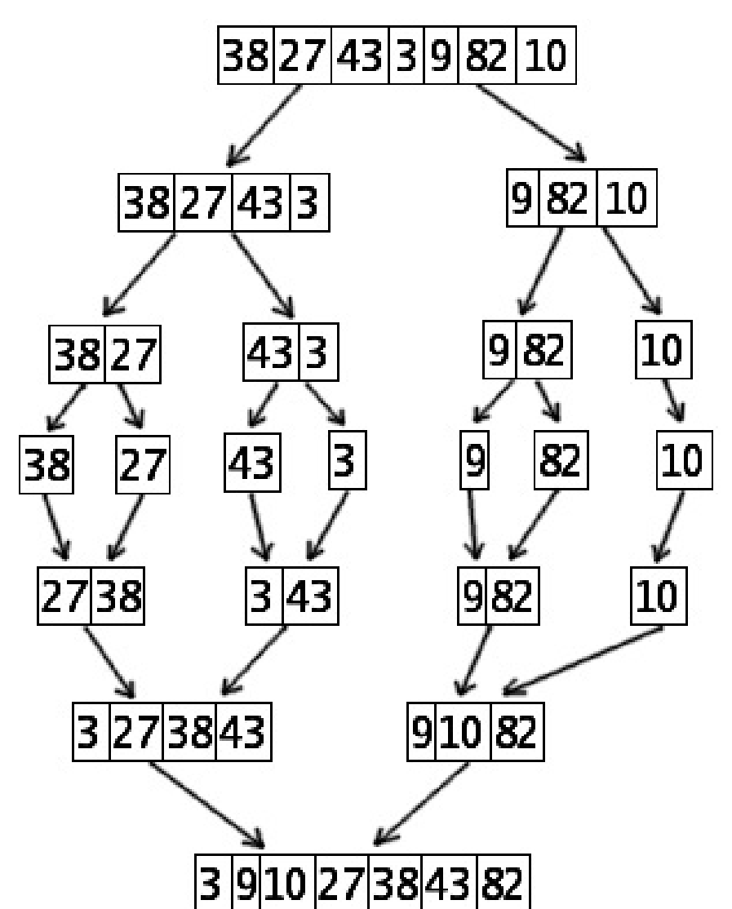
Merge Sort Example

Slide 10
Merge-Sort (A, p, r)
INPUT: a sequence of n numbers stored in array A OUTPUT: an ordered sequence of n numbers
MergeSort (A, p, r) // sort A[p..r] by divide & conquer
1 if p < r
2 then q ← ⎣(p+r)/2⎦
MergeSort (A, p, q)
MergeSort (A, q+1, r)
Merge (A, p, q, r) // merges A[p..q] with A[q+1..r]
Initial Call: MergeSort(A, 1, n)

Slide 11
Procedure Merge
Merge(A, p, q, r)
1 n₁ ← q – p + 1
2 n₂ ← r – q
Input: Array containing sorted subarrays A[p..q] and A[q+1..r].
Output: Merged sorted subarray in A[p..r].
3 for i ← 1 to n₁
4 do L[i] ← A[p + i – 1]
5for j ← 1 to n₂
6do R[j] ← A[q + j]
7 L[n₁+1] ← ∞
8 R[n₂+1] ← ∞
9 i ← 1
10 j ← 1
Sentinels, to avoid having to check if either subarray is fully copied at each step.
11for k ←p to r 12do if L[i] ≤ R[j] 13then A[k] ← L[i]
14 i ← i + 1
15 else A[k] ← R[j]
16 j ← j + 1

Slide 12
Merge Sort
Merge(A, p, q, r)
1 n₁ ← q – p + 1
2 n₂ ← r – q
Loop Invariant for the for loop At the start
of each iteration of the for loop:
Subarray A[p..k – 1] contains the k – p smallest elements of L and R in sorted order. L[i] and R[j] are the smallest elements of L and R that have not been copied back into A.
3 for i ← 1 to n₁
4 do L[i] ← A[p + i – 1]
5for j ← 1 to n₂
6do R[j] ← A[q + j]
7 L[n₁+1] ← ∞
Initialization:
Before the first iteration:
A[p..k – 1] is empty.
i = j = 1.
L[1] and R[1] are the smallest
elements of L and R not copied to A.
8 R[n₂+1] ← ∞
9 i ← 1
10 j ← 1
11for k ←p to r 12do if L[i] ≤ R[j] 13then A[k] ← L[i]
14 i ← i + 1
15 else A[k] ← R[j]
16 j ← j + 1

Slide 13
Merge Sort
Merge(A, p, q, r)
1 n₁ ← q – p + 1
2 n₂ ← r – q
Maintenance:
Case 1: L[i] ≤ R[j]
By LI, A contains p – k smallest elements of L and R in sorted order.
By LI, L[i] and R[j] are the smallest elements of L and R not yet copied into A.
Line 13 results in A containing p – k + 1 smallest elements (again in sorted order). Incrementing i and k reestablishes the LI for the next iteration.
Similarly for L[i] > R[j].
3 for i ← 1 to n₁
4 do L[i] ← A[p + i – 1]
5for j ← 1 to n₂
6do R[j] ← A[q + j]
7 L[n₁+1] ← ∞
8 R[n₂+1] ← ∞
9 i ← 1
10 j ← 1
Termination:
On termination, k = r + 1.
By LI, A contains r – p + 1 smallest elements of L and R in sorted order.
L and R together contain r – p + 3 elements. All but the two sentinels have been copied back into A.
11for k ←p to r 12do if L[i] ≤ R[j] 13then A[k] ← L[i]
14 i ← i + 1
15 else A[k] ← R[j]
16 j ← j + 1

Slide 14
TASKS END OF LECTURE LEARNING (TELL):
Task 1:
Given a sorted array of distinct integers A[1...n], you want to find out whether there is an index i for which A[i] = i. Give a divide and conquer algorithm that runs in O(log n) time to find out an index i if it exists.
Task 2. Suppose you are choosing between the following 3 algorithms:
• Algorithm A solves the problem of size n by dividing it into 5 subproblems of size n/2, recursively solving each subproblem, and then combining the solutions in linear time.
• Algorithm B solves the problem of size n by recursively solving two subproblems of size n − 1 and then combining the solutions in constant time
• Algorithm C solves the problem of size n by dividing it into nine subproblems of size n/3, recursively solving each subproblem, and then combining the solutions in O(n²) time.
What are the running times of each algorithm and which would you choose and why?

Slide 15
TASKS END OF LECTURE LEARNING (TELL):
Task 3:
Trade Unions are common these days in industries. But the new manager of ByteComp doesn’t like those unions. He wants the division between them. Before he goes on the process of division, he wants to find out the number of ways in which he can divide the existing trade union into two parts by kicking out one of the workers. Given N , the number of workers in the company, and ‘R’, the number of connections in the union and R pairs of connections. Find the ways in which the original configuration of the union can be divided.

Slide 16
References
Fundamentals of Computer Algorithms 2nd Edition (2008) by Horowitz, Sahni and Rajasekaran
Introduction to Algorithms 3rd Edition (2012) by Thomas H Cormen, Charles E Lieserson, Ronald

Slide 17
THANK YOU
For queries
Email: vikash.e13657@cumail.in

